Slide 1

Hotel Reservation Analysis with SQL
By Nidhi Sharma

Slide 2
Introduction
The hotel industry operates in a highly competitive environment where data-driven decision-making is crucial for enhancing guest experiences and optimizing operational efficiency.
This project aims to delve into a hotel reservation dataset to extract valuable insights regarding guest preferences, booking patterns, and various factors influencing hotel operations. By leveraging SQL, the project will involve querying and analyzing the data to answer specific questions, providing actionable information to help the hotel improve its services and strategies effectively.

Slide 3
Objective
This project's main goal is to analyze the hotel reservation dataset in order to find patterns that will help decision-makers. The exact objectives consist of:
Recognize recurring themes in visitor preferences, such as preferred accommodation categories and menu items.
Examine booking patterns, taking into account lead times, length of stays, and week and weekend variances.
Assessing Market Segments: Find out which market segments and how they are most profitable.
Streamlining Operations: Make suggestions for streamlining operations based on the examination of reservation statuses, lodging rates, and other pertinent data.
This analysis will help the project increase overall efficiency and better serve the needs of the hotel's patrons.

Slide 4

Dataset details
The dataset includes the following columns
Booking_ID: A unique identifier for each hotel reservation.
no_of_adults: The number of adults in the reservation.
no_of_children: The number of children in the reservation.
no_of_weekend_nights: The number of nights in the reservation that fall on weekends.
no_of_week_nights: The number of nights in the reservation that fall on weekdays.
type_of_meal_plan: The meal plan chosen by the guests.
room_type_reserved: The type of room reserved by the guests.
lead_time: The number of days between booking and arrival.
arrival_date: The date of arrival.
market_segment_type: The market segment to which the reservation belongs.
avg_price_per_room: The average price per room in the reservation.
booking_status: The status of the booking.

Slide 5
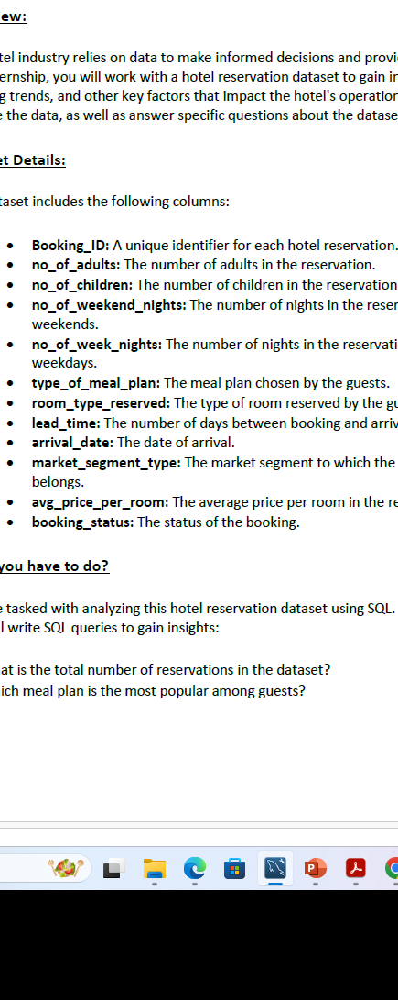
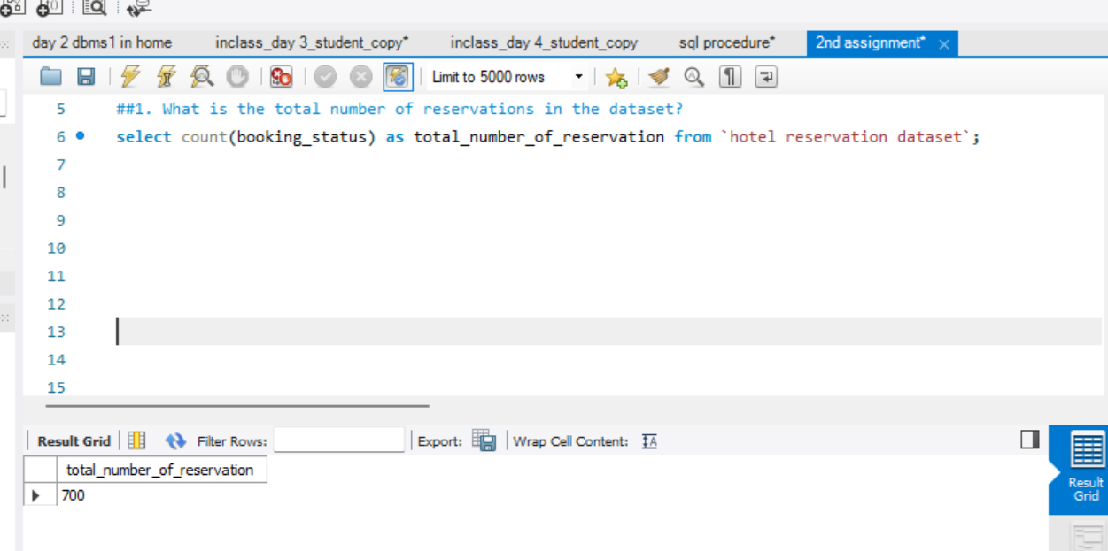
1. What is the total number of reservations in the dataset?

Slide 6
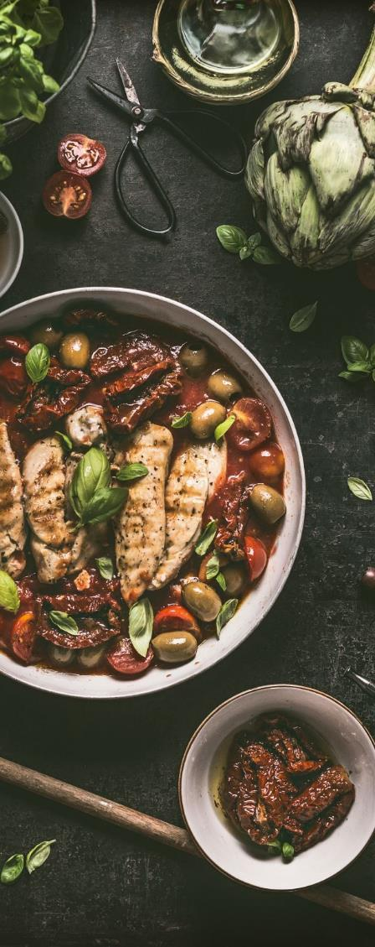
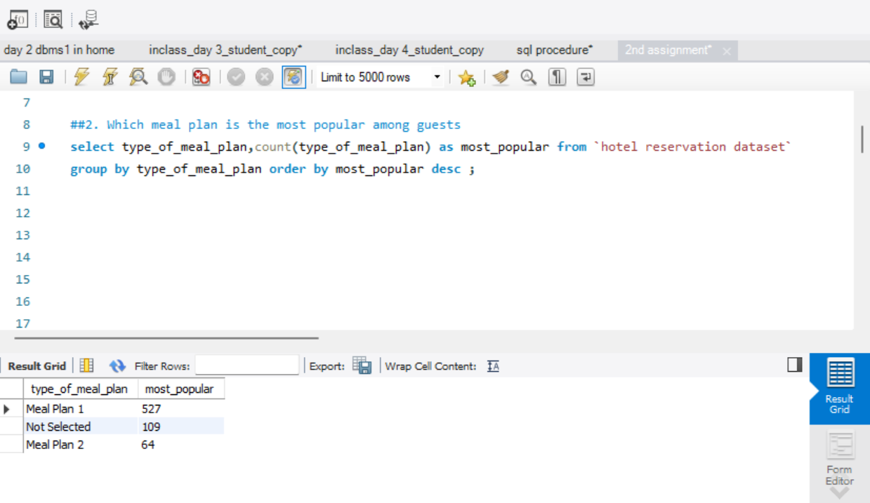
2. Which meal plan is the most popular among guests?

Slide 7
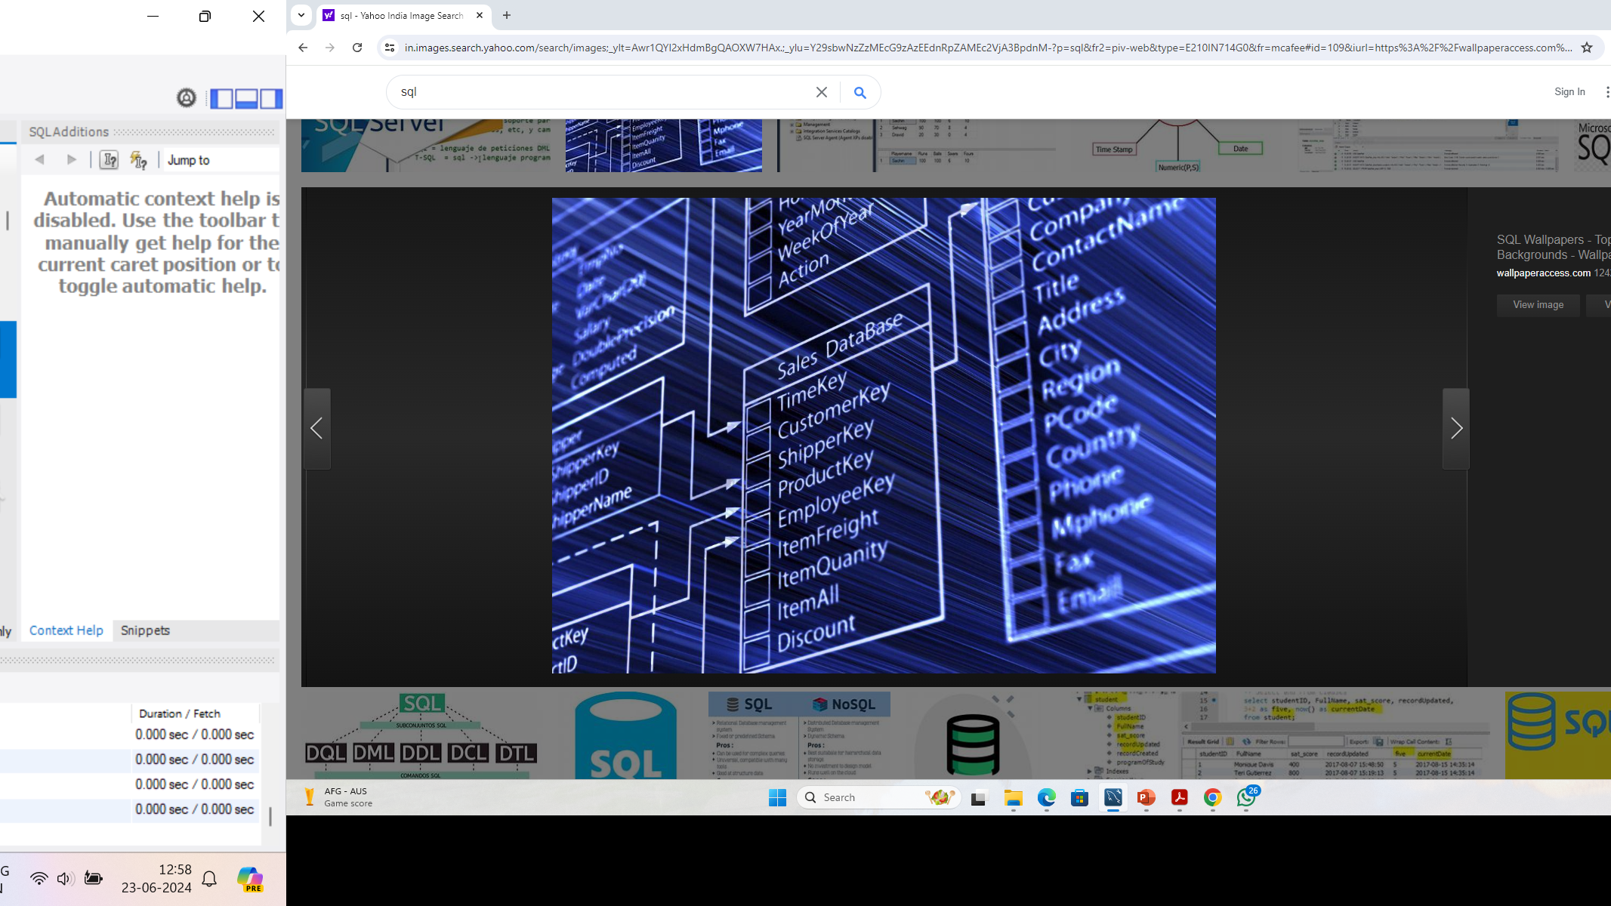
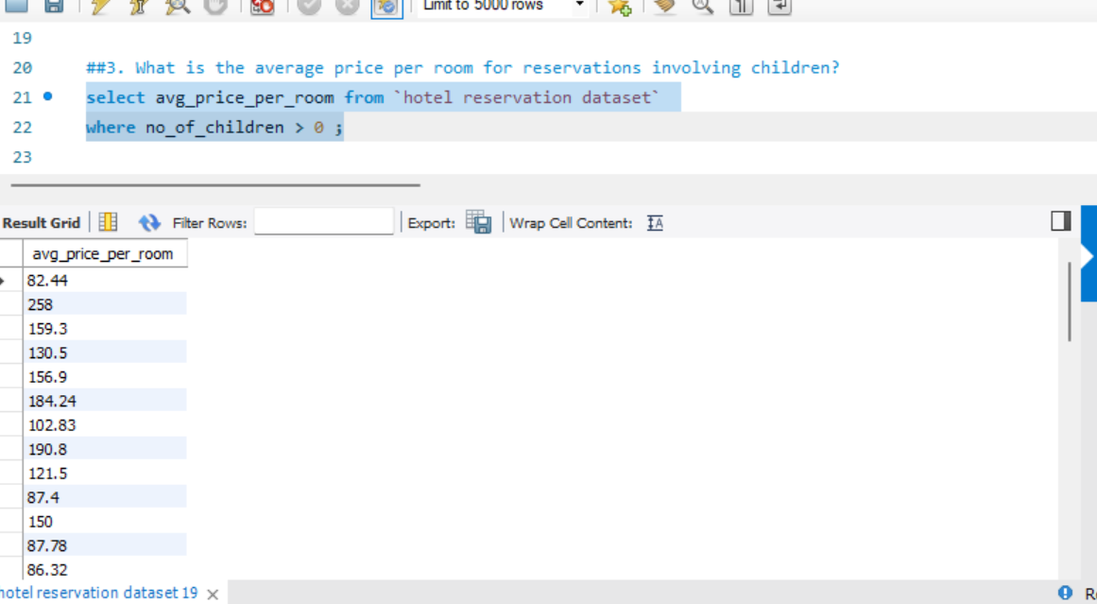
3. What is the average price per room for reservations involving children?

Slide 8
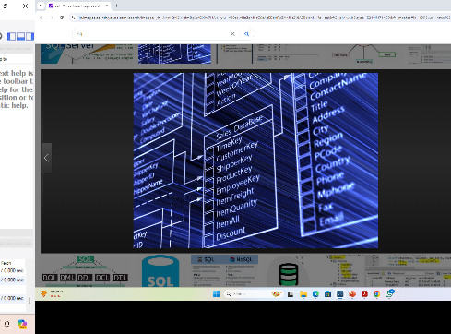
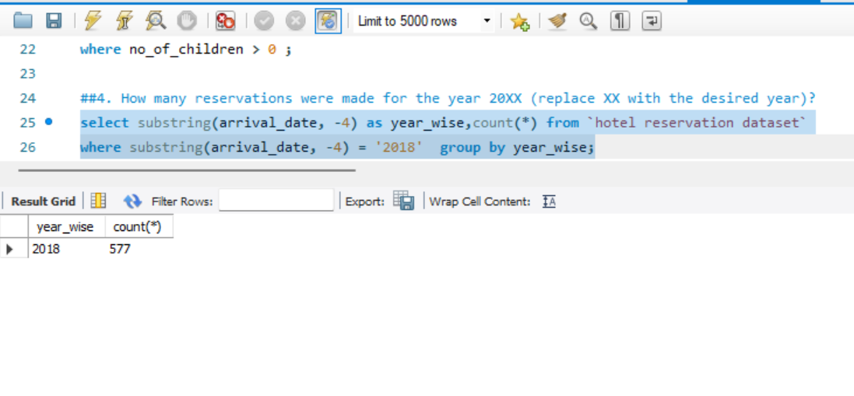

4. How many reservations were made for the year 20XX (replace XX with the desired year)?

Slide 9

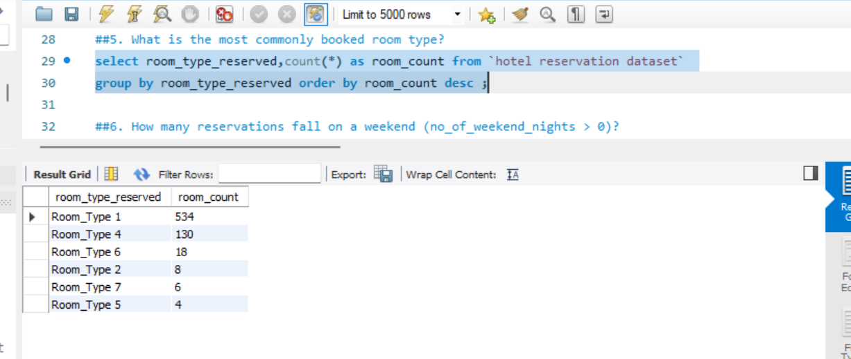
5. What is the most commonly booked room type?

Slide 10
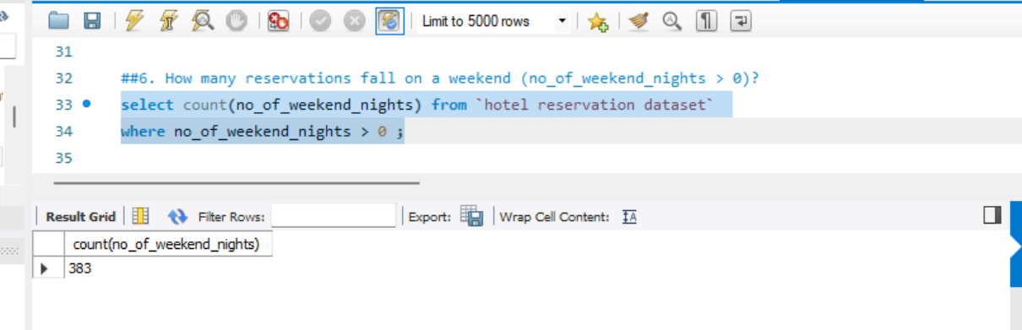
6. How many reservations fall on a weekend (no_of_weekend_nights > 0)?

Slide 11
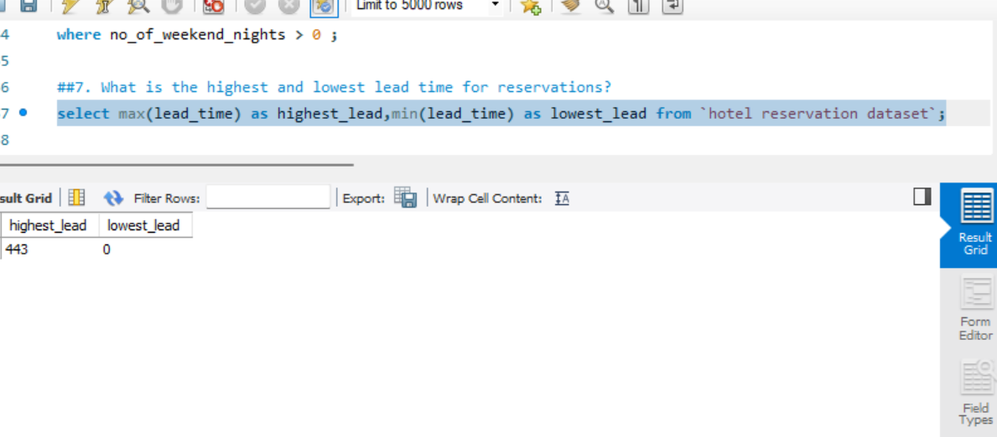
7. What is the highest and lowest lead time for reservations?

Slide 12
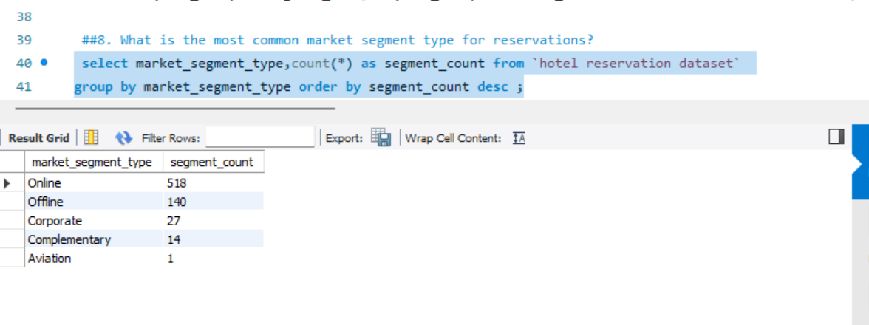
8. What is the most common market segment type for reservations?

Slide 13
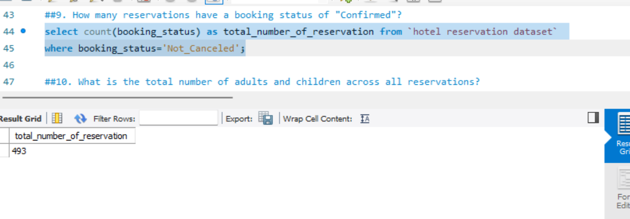
9. How many reservations have a booking status of "Confirmed"?

Slide 14
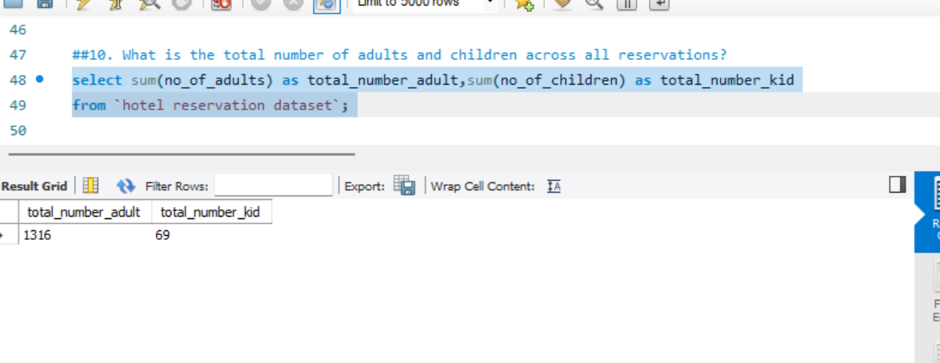
10. What is the total number of adults and children across all reservations?

Slide 15
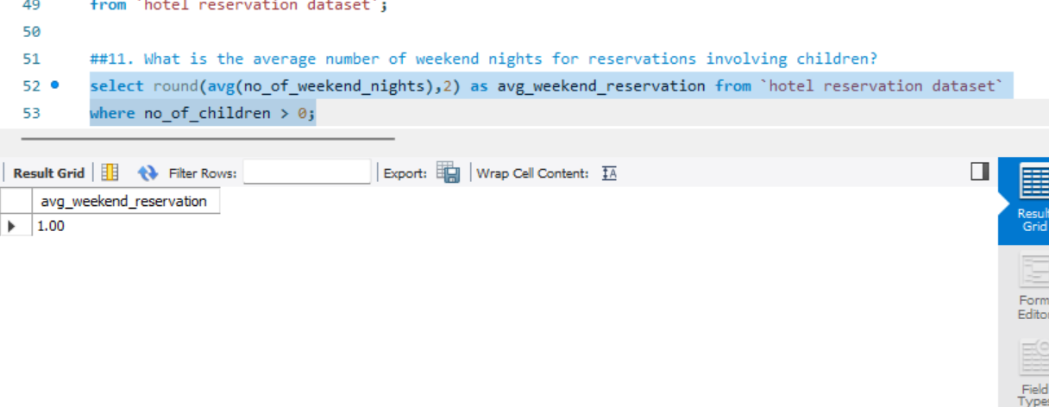
11. What is the average number of weekend nights for reservations involving children?

Slide 16
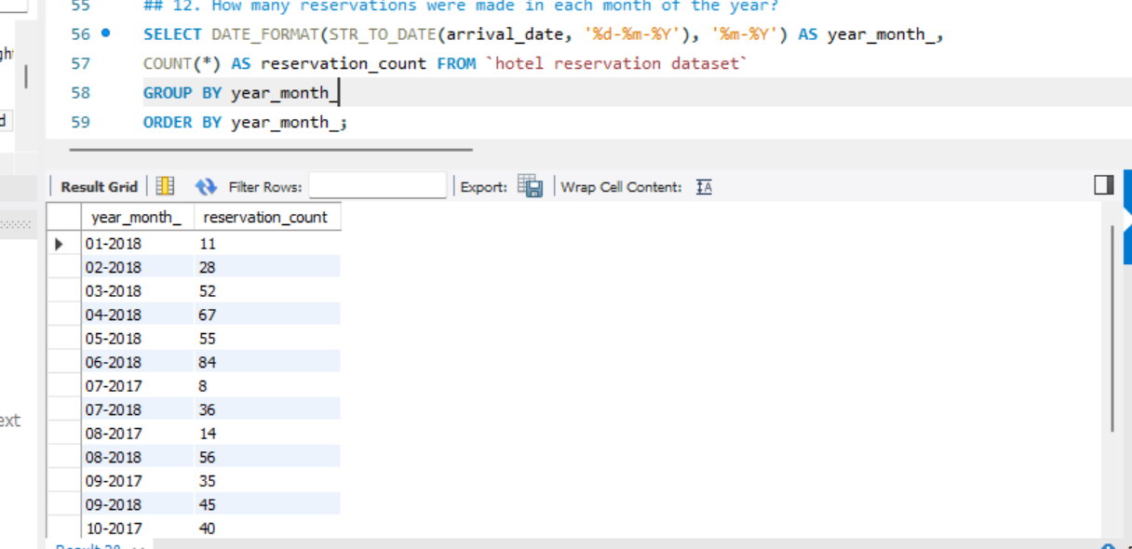
12. How many reservations were made in each month of the year?

Slide 17

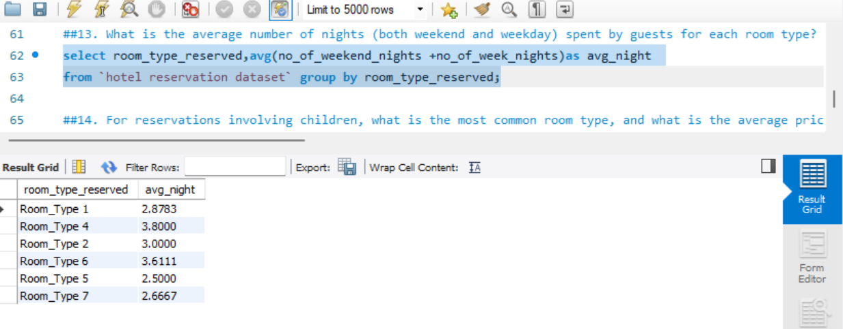
13. What is the average number of nights (both weekend and weekday) spent by guests for each room type?

Slide 18

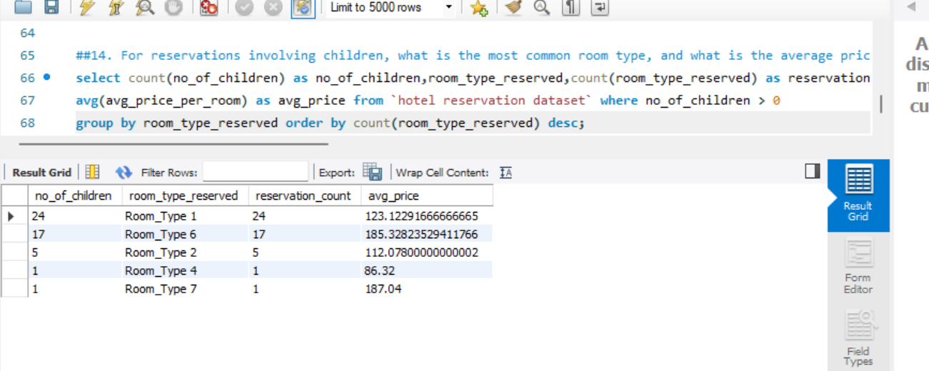
14. For reservations involving children, what is the most common room type, and what is the average price for that room type?

Slide 19

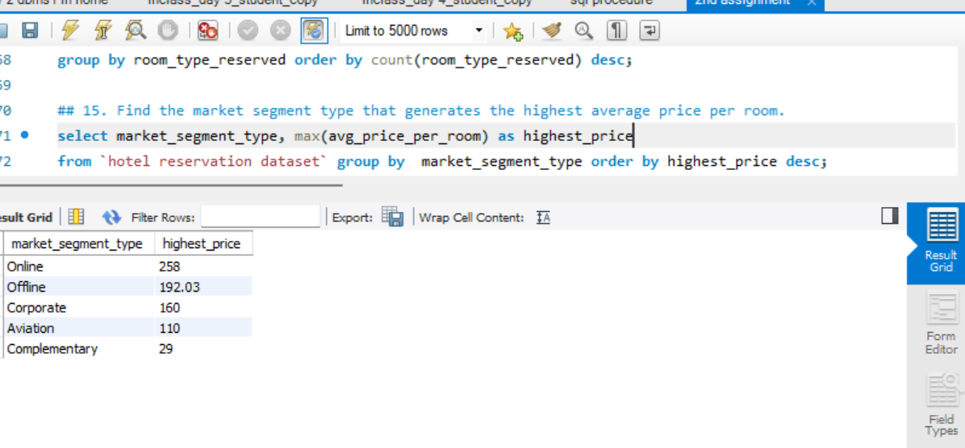
15. Find the market segment type that generates the highest average price per room.

Slide 20

Conclusion
The total number of reservations is 700.
The most popular meal plan among guests is Meal Plan 1, with 527 reservations.
The most commonly preferred room type among guests is Room Type 1.
The common market type of room reservation is Online with 518 reservations, followed by Offline with 140 reservations.
The most common room type preference for families with children are Room Type 1.
The average price of Room Type 1, which is preferred by families with children, is $123.12.
The highest average price per room is generated by the Online market segment, with an average price of $258.
These insights provide a comprehensive overview of guest preferences, booking trends, and market segment dynamics based on the analysis of the hotel reservation dataset. This information can guide strategic decisions to optimize operations, enhance guest satisfaction, and maximize revenue in the hospitality industry.

Slide 21
Thank you

